Slide 1

RESCUESLOT:
Intelligent Food Rescue Pickup Schedule
01
PREPARED BY:
HERASHINI RAMAN
QIU-202410-007855
BIT3203
AI Method:
Constraint Satisfaction Problem (CSP)

Slide 2



RESCUESLOT
The Problem
Food wastage remains a challenge as restaurants and cafes often have excess food at the end of the day.
At the same time, food rescue organisations depend on volunteers to collect and distribute donated food.
However arranging pickups is difficult because:
Volunteers have different availability times
Vehicles have different capacity limits
Food must be collected before expiry
This creates a scheduling problem that requires multiple constraints to be considered.
PROBLEM BACKGROUND
02

Slide 3

PROPOSED SOLUTION
RescueSlot
RescueSlot is an AI-based food rescue pickup scheduler that helps assign volunteers to pickup tasks.
The system:
Matches food pickups with suitable volunteers
Checks volunteer availability
Checks vehicle capacity
Generates a valid pickup schedule automatically
The goal is to make food rescue coordination easier and reduce food wastage.
03

Slide 4


AI TECHNIQUE USED
CONSTRAINT SATISFACTION PROBLEM (CSP)
The project uses:
CSP with Backtracking Search and MRV Heuristic
CSP Components:
Variables
Food pickup tasks
Domains
Available volunteers
Constraints
Volunteer availability
Vehicle capacity
Pickup requirements
The system searches for assignments that satisfy all constraints.
04

Slide 5



RESCUESLOT
Input Information
(Restaurants, Food Weight,
Pickup Time, Volunteers)
1.
SYSTEM WORKFLOW
CSP Solver
(Backtracking + MRV)
2.
05
3.
Constraint Checking
4.
Valid Pickup Schedule
The system rejects assignments that violate constraints.

Slide 6
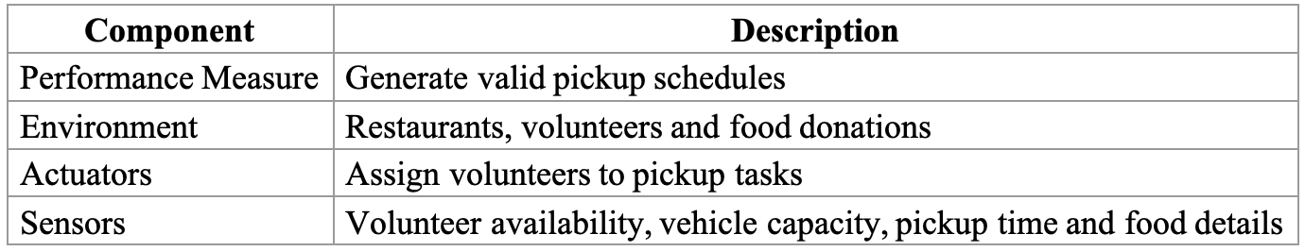
PEAS DESCRIPTION
06

Slide 7
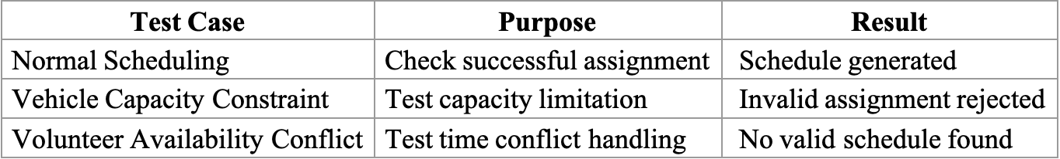
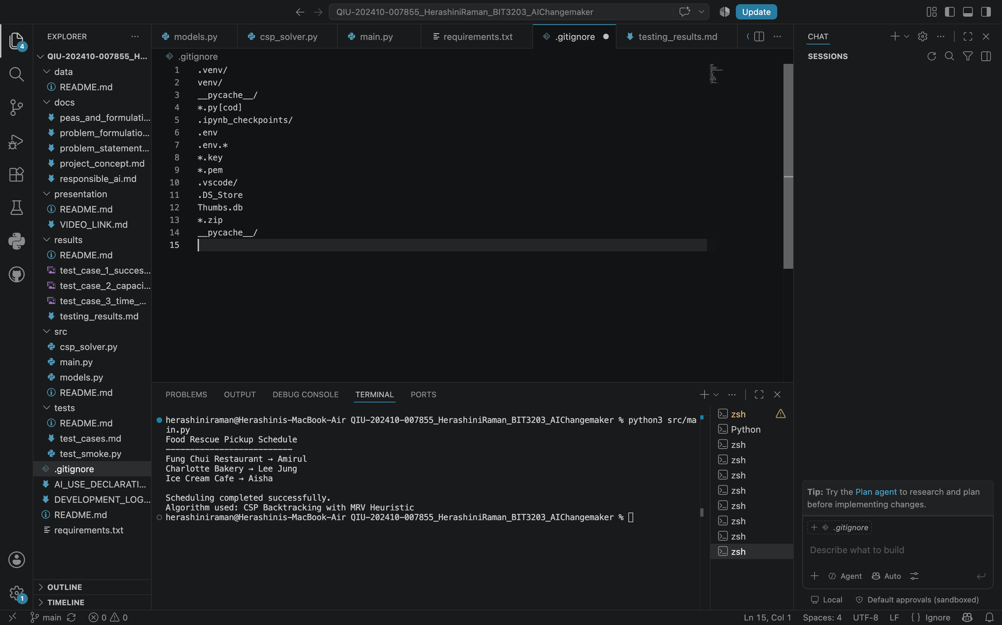
TESTING RESULTS
SYSTEM EVALUATION
THREE SCENARIOS WERE TESTED.
07
Example successful output:

Slide 8
LIMITATIONS & FUTURE IMPROVEMENT
Current Limitations
Uses simulated data instead of real food rescue data
Does not include GPS/location optimisation
Volunteer information is entered manually
08
Future Improvements
Real-time volunteer availability updates
Map and distance optimisation
Mobile application integration

Slide 9

RESCUESLOT
CONCLUSION
09
RESCUESLOT DEMONSTRATES HOW ARTIFICIAL INTELLIGENCE CAN BE APPLIED TO SOLVE REAL-WORLD SCHEDULING PROBLEMS.
BY USING CSP, BACKTRACKING SEARCH AND MRV HEURISTIC, THE SYSTEM CAN GENERATE SUITABLE VOLUNTEER ASSIGNMENTS WHILE CONSIDERING IMPORTANT CONSTRAINTS.
THE PROJECT SHOWS HOW AI CAN SUPPORT MORE EFFICIENT FOOD RESCUE OPERATIONS.
14
2.

Slide 10
RESCUESLOT
THANK
10
YOU.

